Slide 1
Lecture Notes: Warping and Rotating Images

Slide 2
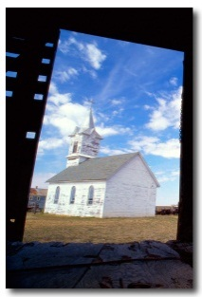
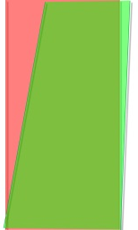
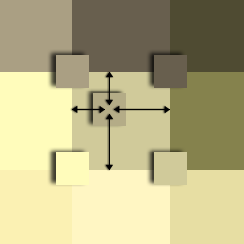

Geometric Remapping
Input Image
Warping Function
Interpolation Function
Output Image

Slide 3
Geometric Remapping
Assume the input image, I, has infinite spatial resolution.
Calculate the size, R_{out}×C_{out}×B, of the output image, J, and allocate it.
Create an image map (a warping function, Φ) as follows:
Allocate an R_{out}×C_{out}×2 array, Φ.
For every pixel location (r,c) in J find the corresponding real-valued pixel location (r_{f} ,c_{f}) in I.
Set Φ(r,c,1) = r_{f} and set Φ(r,c,2) = c_{f} .
Create an interpolation function, Θ, that generates a pixel value from the values of I on a neighborhood, N(r_{f} ,c_{f}).
Then set J(r,c) = Θ{I; N(r_{f} ,c_{f})}.

Slide 4

Linear Warping of Images
Photo: JBUK_Planet, http://www.flickr.com/people/jbuk_planet/, Highclere Castle, Highclere Park, Newbury RG20 9RN, England, http://www.highclerecastle.co.uk/, August 26, 2007, Kodak DX6440
Original image with perspective distortion.

Slide 5

Linear Warping of Images
Image warped to correct perspective distortion.

Slide 6
Linear Warping of Images
Select at least 4 key points that are easy to correct.
(412, 34)
E.g. in this case, the lines should be perfectly vertical.
(80, 326)
(872, 239)
(52, 632)
(403, 652)
(913, 624)
Selected correction points.

Slide 7
Linear Warping of Images
Here, align the top points with the bottom points.
(403, 34)
I.e. the top column coordinates == the bottom col. Cdts.
(52, 326)
(913, 239)
(52, 632)
(403, 652)
(913, 624)
Target correction points.

Slide 8
Linear Warping of Images
The top part of the image has been stretched more than the bottom
(403, 34)
Now the building corners are vertical.
(52, 326)
(913, 239)
(52, 632)
(403, 652)
(913, 624)
Result of linear LMS point remapping.

Slide 9
Linear Warping of Images
The top part of the image has been stretched more than the bottom
Now the building corners are vertical.
Image warped to correct perspective distortion.

Slide 10
Linear Warping of Images – How To Do It
Given a set, X, of points from image I and a set, Y, of target points find H such that:
where
and
is the warped image.
then
Notes:
Show that a 2x2 transform simply rotates-stretches-rotates , and that this does not correct for perspective distortion. Add to this, a very brief explanation of projective geometry. Use a projective plane diagram like eece254/Fall 2011/Graphics/Projective Plane 3.ai. Show the equivalence class of points on a ray. Then use an image plane for the unwarped result and a rotated plane for the warped image to show how the images map to each other as a result of projective geometry.

Slide 11
Linear Warping of Images – How To Do It
Given a set, X, of points from image I and a set, Y, of target points find H such that:
Then for each pixel in the output image, select the corresponding input pixel:
The H that minimizes the square of the difference between Y and HX is:
where
Notes:
Show that a 2x2 transform simply rotates-stretches-rotates , and that this does not correct for perspective distortion. Add to this, a very brief explanation of projective geometry. Use a projective plane diagram like eece254/Fall 2011/Graphics/Projective Plane 3.ai. Show the equivalence class of points on a ray. Then use an image plane for the unwarped result and a rotated plane for the warped image to show how the images map to each other as a result of projective geometry.

Slide 12
Linear Warping of Images – How To Do It
Example:
Next 2 images: p. 13 original; p. 14 result of warping the image with the H above.
Notes:
Show that a 2x2 transform simply rotates-stretches-rotates , and that this does not correct for perspective distortion. Add to this, a very brief explanation of projective geometry. Use a projective plane diagram like eece254/Fall 2011/Graphics/Projective Plane 3.ai. Show the equivalence class of points on a ray. Then use an image plane for the unwarped result and a rotated plane for the warped image to show how the images map to each other as a result of projective geometry.

Slide 13
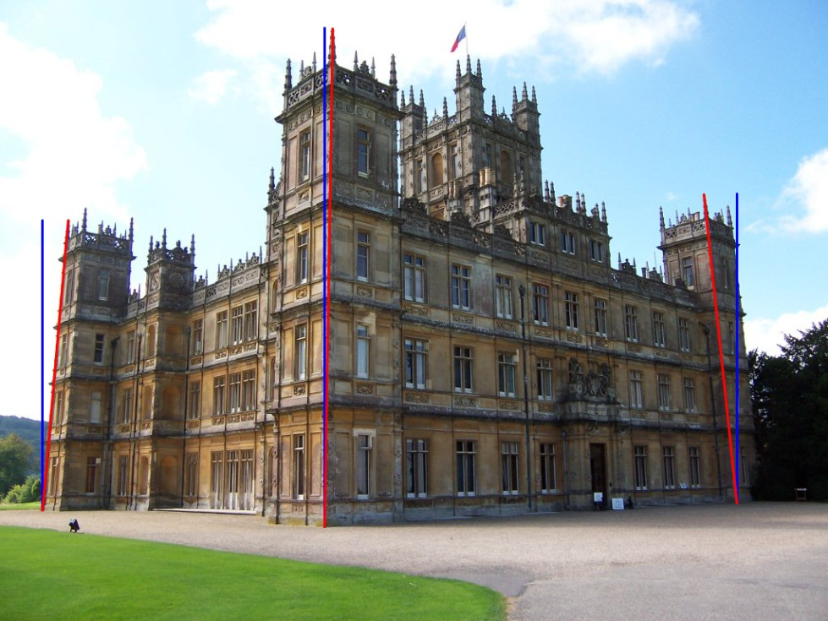
Linear Warping of Images – How To Do It
Original image with distorted (red) and undistorted (blue) lines.

Slide 14
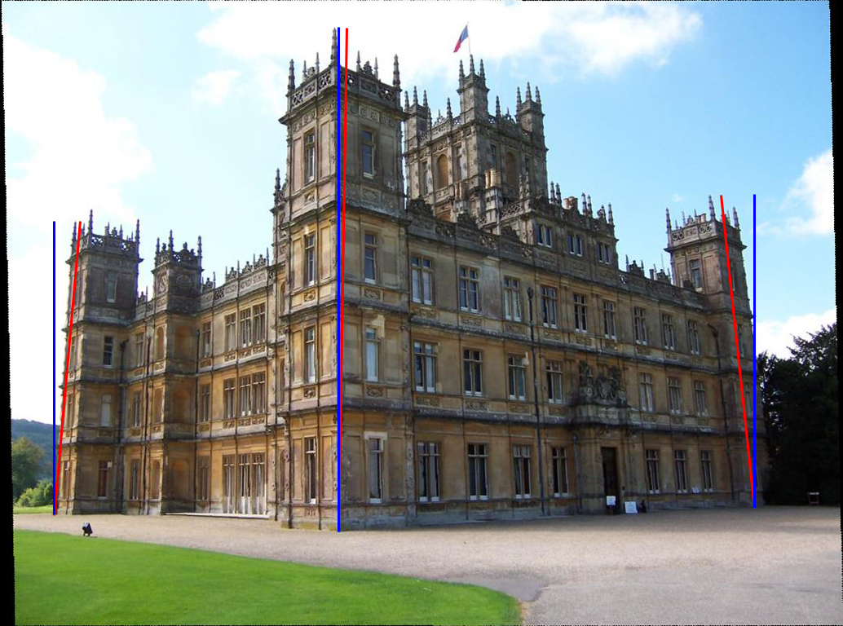
Linear Warping of Images – How To Do It
This is pretty bad!
Why?
Because the stretch that we want to perform is not linear in 2D.
Warped image with distorted (red) and undistorted (blue) lines.

Slide 15
Linear Warping of Images – How To Do It
Multiplication of a vector by an arbitrary matrix rotates the vector, stretches the result along its coordinates and rotates the result of that.
where U and V are rotations and S is diagonal. For the example:
CW rotation 19.6293°
Recall:
CCW rotation -18.9863°
Next 3 images:
p. 16 rotated by V^{T};
p. 17 rot. V^{T}, scaled by S;
p. 18 rot. V^{T}, scaled S, rot. U;
stretch rotated columns by 3.2%; compress rotated rows by 99.6%
Notes:
Show that a 2x2 transform simply rotates-stretches-rotates , and that this does not correct for perspective distortion. Add to this, a very brief explanation of projective geometry. Use a projective plane diagram like eece254/Fall 2011/Graphics/Projective Plane 3.ai. Show the equivalence class of points on a ray. Then use an image plane for the unwarped result and a rotated plane for the warped image to show how the images map to each other as a result of projective geometry.

Slide 16

Linear Warping of Images – How To Do It
Original image rotated by V^{T}.

Slide 17

Linear Warping of Images – How To Do It
Original image rotated by V^{T} and stretched by S.

Slide 18

Linear Warping of Images – How To Do It
Original image rotated by V^{T}, stretched by S, and rotated by U.

Slide 19
Linear Warping of Images – How To Do It
Given a set, X, of points from image I and a set, Y, of target points find H such that
where
There is a problem, however. This does not work very well.
This is a 2D linear transform.
What we need is a 3D project- tive transform. A 3rd dimension enables us to model more ge-neral projections. Thus we use 3D “homogeneous” coordinates.
and
is the warped image.
then

Slide 20
A Hierarchy of Transformations
Isometry:
Similarity:
Affine:
Projective:
Generality
H_{e}
H_{s}
H_{a}
H_{p}
Inclusion

Slide 21
Projective Transformation
Invariants:
cross ratio of four points on a line (ratio of ratio of lengths)
2-D:
n-D:
Important: In the slides that follow, x = c, the column location of a pixel and y = r, the pixel’s row location.
H_{p}

Slide 22
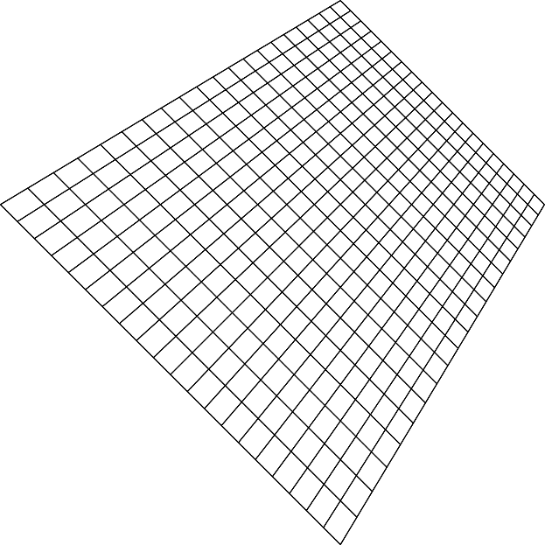

Projective
Transformations
Invariants:
cross ratio of four points on a line (ratio of ratio of lengths)

Slide 23
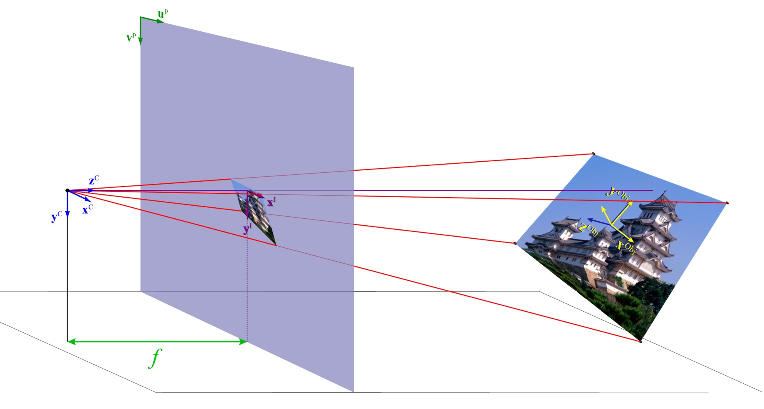
Homographies
The projective transformation that represents the mapping between two planes in 3-space.

Slide 24

Homographies
The projective transformation that represents the mapping between two planes in 3-space.
Object points w.r.t. the object coordinate system.

Slide 25

Homographies
The projective transformation that represents the mapping between two planes in 3-space.
Object points w.r.t. the object coordinate system.
Image points w.r.t. the image coordinate system.

Slide 26
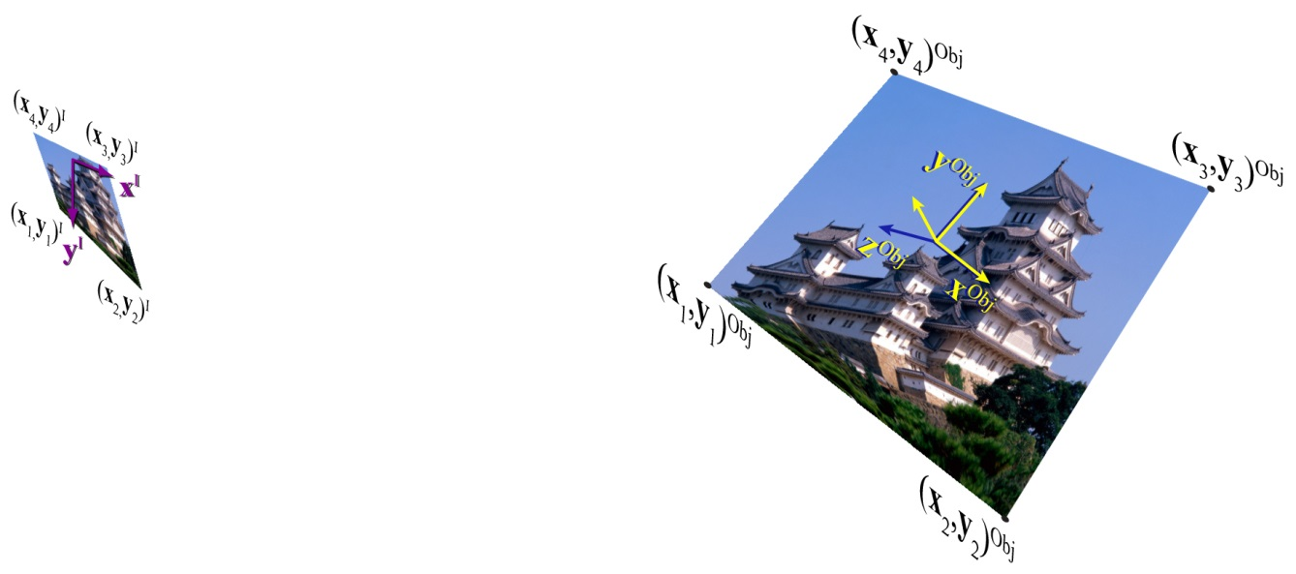
Homographies
The projective transformation that represents the mapping between two planes in 3-space.
Image points w.r.t. the image coordinate system.
Object points w.r.t. the object coordinate system.

Slide 27
Homographies in 3-D projective space
Place a 1 in the 4th dimension of each input pixel location.
H is 4×4.
The remapped pixel locs are also 4-D. Call each 4th element k_{i} and write the other three as proportional to k_{i.}

Slide 28
Homographies in 3-D projective space
So, in general the homography looks like an ordinary 4D linear transform:
This would require a minimum of 16 equations to solve for all the parameters. If, however, we consider the geometry and make some reasonable assumptions, the problem becomes far simpler. We can set z_{i}=0 and w_{i}=0 and drop one dimension from the computation

Slide 29
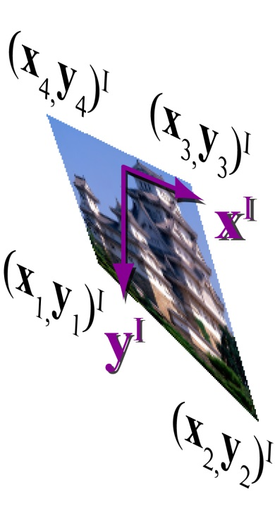
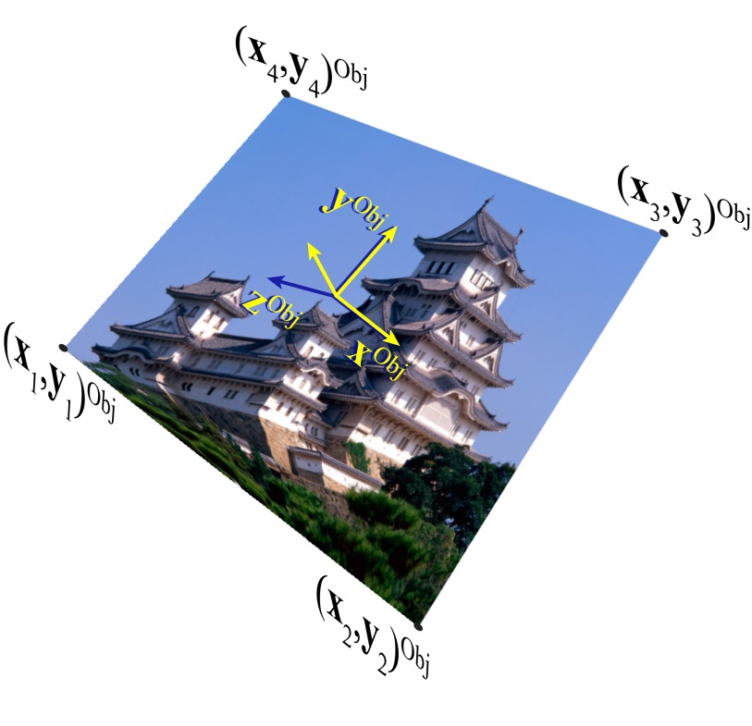
Homographies in 3-D projective space
We are mapping from one plane into another. Therefore we can assume the two coordinate systems have their x- and y-axes in the plane with z = 0.
So the mapping is from 2-D to 2-D between projective planes.

Slide 30
Linear Warping of Images – Homogeneous Cdts.
Important: In the in these equations and those that follow x = c_{in} and u = c_{out}, the column locations of a pixel; y = r_{in} and v = r_{out}, the the pixels’ row location.
Place a 1 in the 3rd dimension of each input pixel location.
H is 3×3.
The remapped pixel locs are also 3D. Call each 3rd element k_{i} and write the other two as proportional to k_{i.}

Slide 31
Linear Warping of Images – Homogeneous Cdts.
Input pixel locations in homogeneous form written as a 3×3 matrix.
H is 3×3.
Remapped pixel locations in homogeneous form written as a 3×3 matrix. Note that usually each k_{i} is different.
Here, for vectors x_{i} and y_{i} are the elements of the transform.

Slide 32
Linear Warping of Images – Derivation
For each pixel location there are 3 equations in 3 unknowns.
Divide the 1st and 2nd equations by the 3rd.
Divide both numerator and denominator by h₃₃. Then relabel the coefficients.

Slide 33
Linear Warping of Images – Derivation
Multiply both sides by the right’s denominator.
Subtract the right side from both sides.
Write as a matrix equation where …
… the elements of matrix H are written as vector h.

Slide 34
Linear Warping of Images – Derivation
Collect p ≥ 4 pixel locations, remap them as desired, and form the matrix A.
Solve for h such that,

Slide 35
Linear Warping of Images – Derivation
If the previous def of A led to H that gave wrong results, try this one:
This matrix follows from the fact that if y = Hx, then y×Hx = 0.
Solve for h such that,

Slide 36
Linear Warping of Images – Derivation
To find h compute the singular value decomposition (svd) of A.
S is a diagonal matrix of singular values.
Write matrix V in terms of its columns.
Find σ_{k}, the smallest sv.
Then vector h is given by the k^{th} column vector, v_{k}.

Slide 37
Linear Warping of Images – Derivation
If v_{k} is the column vector of V that corresponds to the smallest singular value, then H is given by
Now (r_{I},c_{I}) maps to (r_{J},c_{J}) through H so that.
But we want to scan the output image, J, and at each location (r_{J},c_{J}) take a value from I at location (r_{I},c_{I}), so we do this:

Slide 38
Linear Warping of Images – Remapping
The inverse mapping of (r_{J},c_{J},1) through H⁻¹ is (kr_{I},kc_{J},k)…
…and that must be normalized as follows:
Thus for each pixel location (r_{J},c_{J}) in the warped image,

Slide 39
Linear Warping of Images – Steps
4 points is the minimum. Usually, more points lead to better results.
Select at least four pixel locations from I, the image to be warped.
Create target locations by altering the values of the selected locs.
Construct from the location pairs, matrix A as described on slide 34.
Compute the singular value decomposition of A = USV^{T}.
Select the vector v_{k} that corresponds to the smallest singular value.
Construct H from v_{k} .
Compute H⁻¹.
Create an output image J.
For each (c_{J} , r_{J} ) in J, select (c_{I} , r_{I} ) from I using the eqns. on slide 38.
Since (c_{I} , r_{I} ) is fractional, interpolate on the neighborhood of (c_{I} , r_{I} ) in I to compute J(r_{J} , c_{J} ).
The homographic transformation uses pixel coordinates in (column, row) order whereas the images are indexed (row, column).

Slide 40
Image Pixel Locations and Planar Coordinates
Matlab function, ginput() can be used to obtain coordinates in a figure window that contains either a graph or an image. However its behavior is different in each case.
When it is used to select a point in a figure window that contains a plot, ginput() returns real number locations in the form (x,y) where x and y are the usual right-hand-rule rectangular coordinates indexed from the lower left with origin (x,y) = (0,0).
When it is used to select a point in a figure window that contains an image, ginput() returns real number locations in the form (c,r) where c and r are the column and row sub-pixel coordinates of the selected pixel indexed from the upper left with origin (c,r) = (1,1) – the usual left-handed image coordinate system.
When collecting points for a homography, computing it, and remapping an image, if you substitute (c,r) for (x,y) consistently, the transformations will be correct. If the transform is wildly wrong you may have gotten them switched.

Slide 41
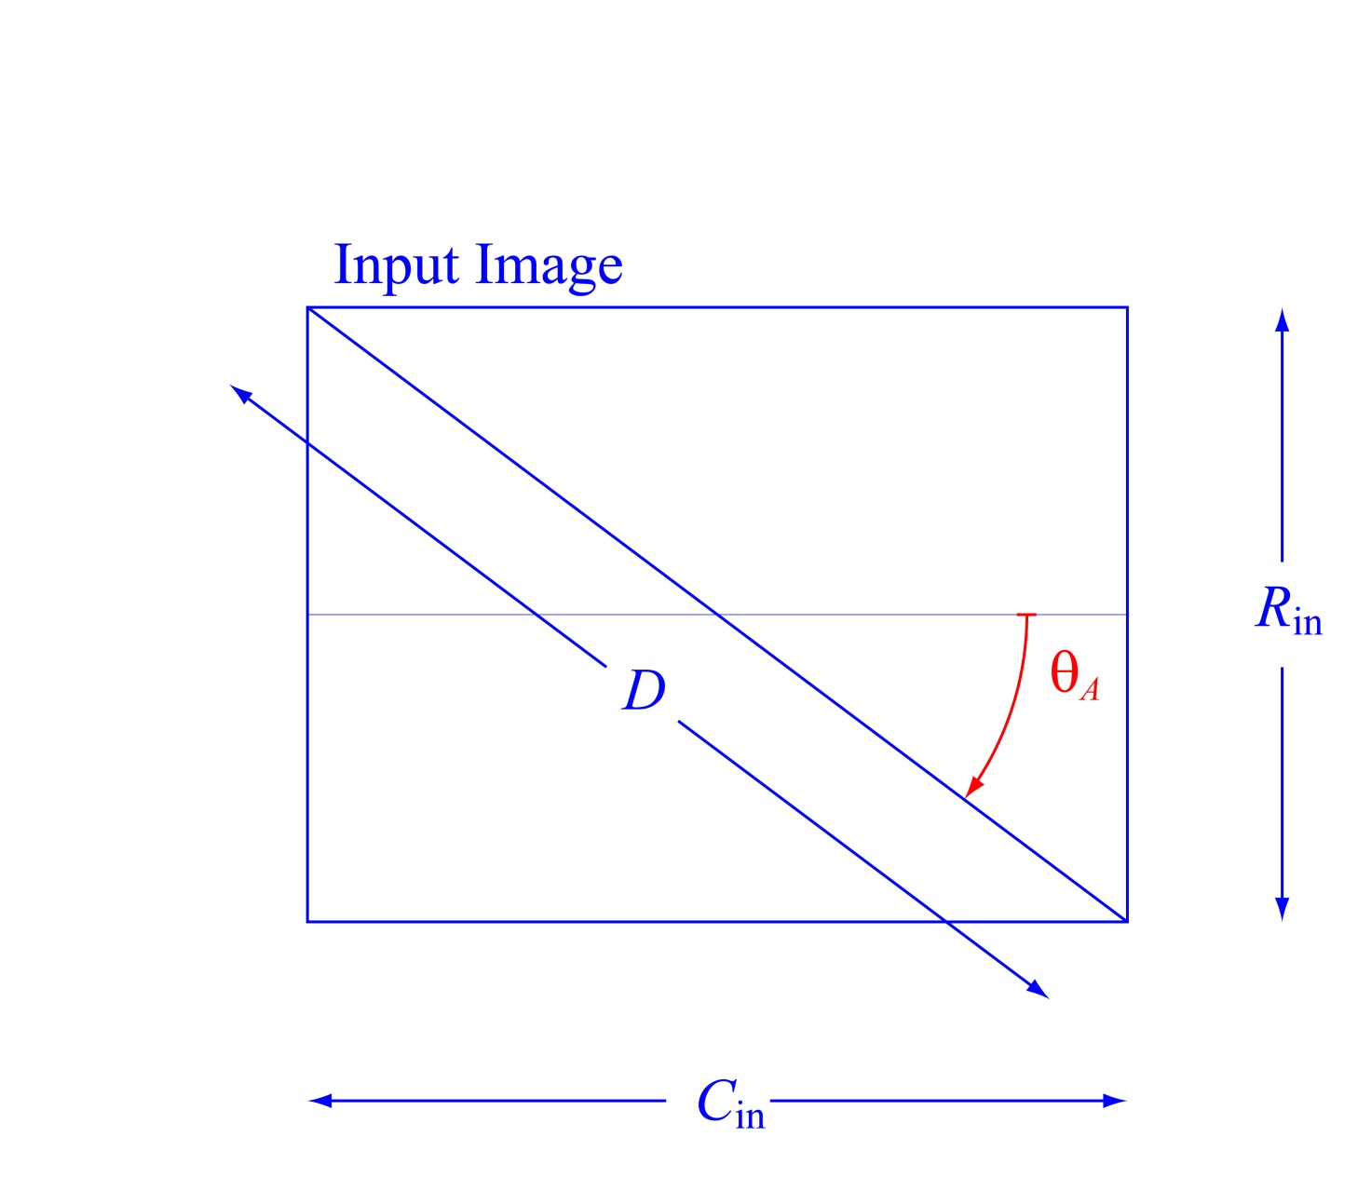
Image Rotation
image size:
aspect angle:
length of diagonal:

Slide 42
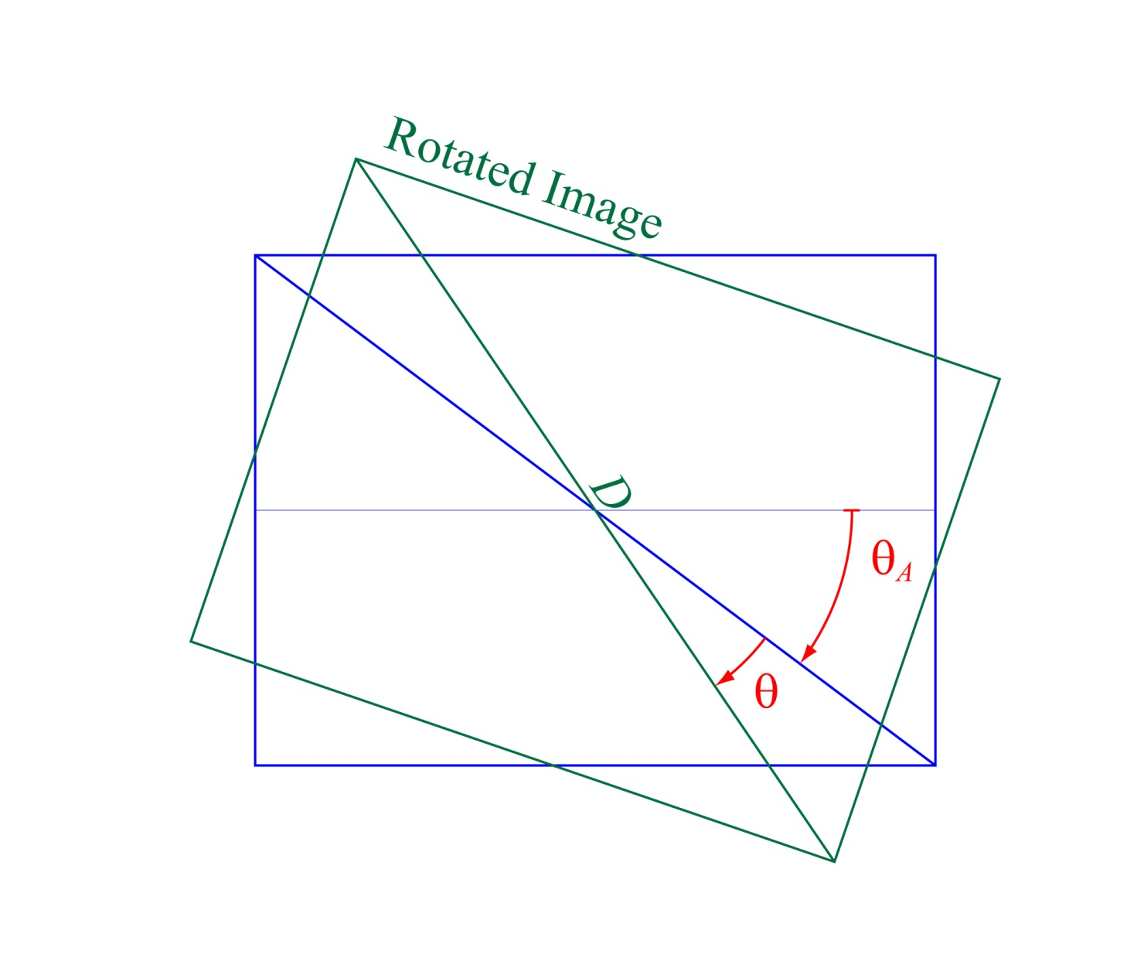
Image Rotation
angle of rotation: θ
rotation matrix:
transforms input image cdts.¹ to output image cdts.
¹ cdts. measured w.r.t. the center of the image:

Slide 43
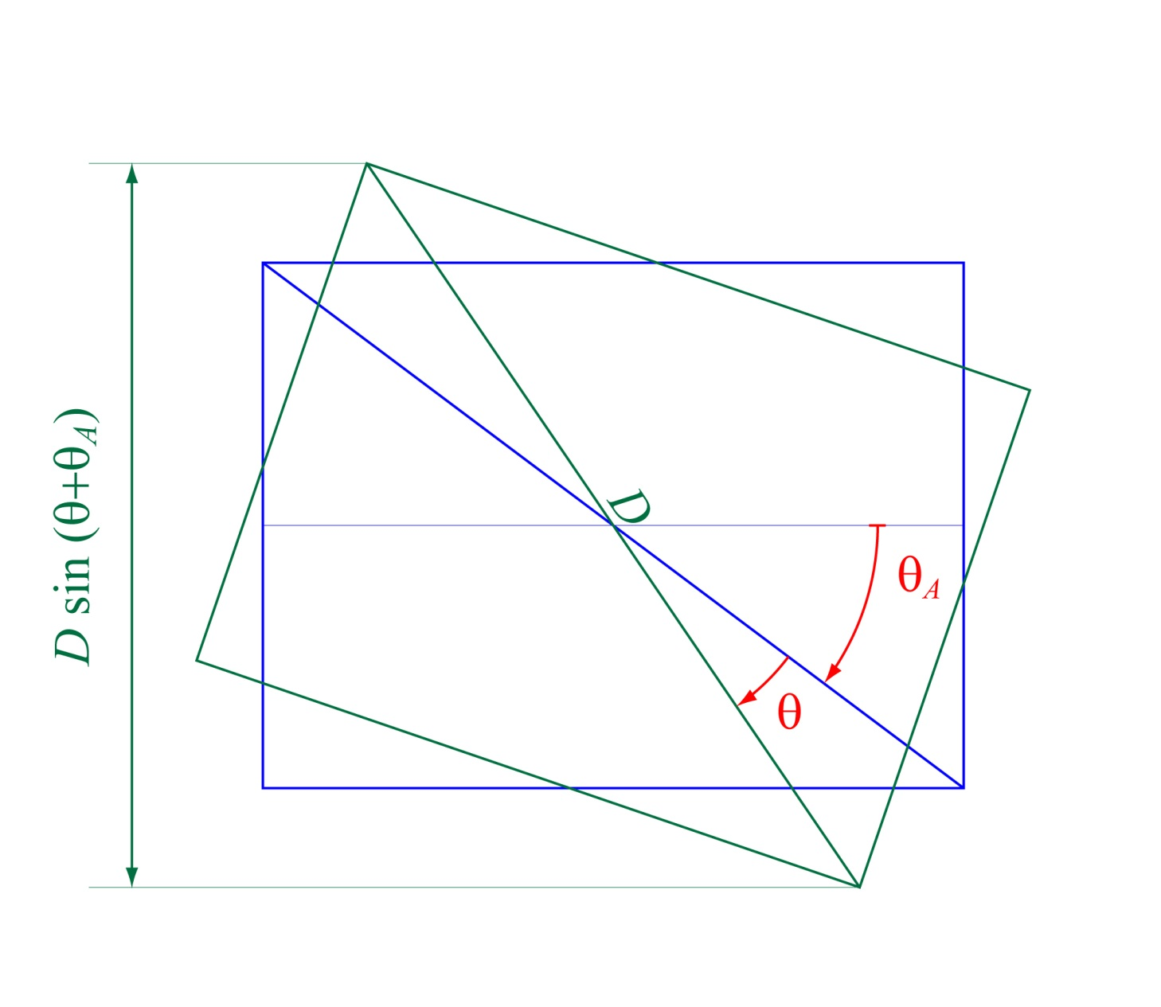
Image Rotation
Compute the dimensions of the output image: number of rows.
if 0° < θ ≤ 90°.

Slide 44
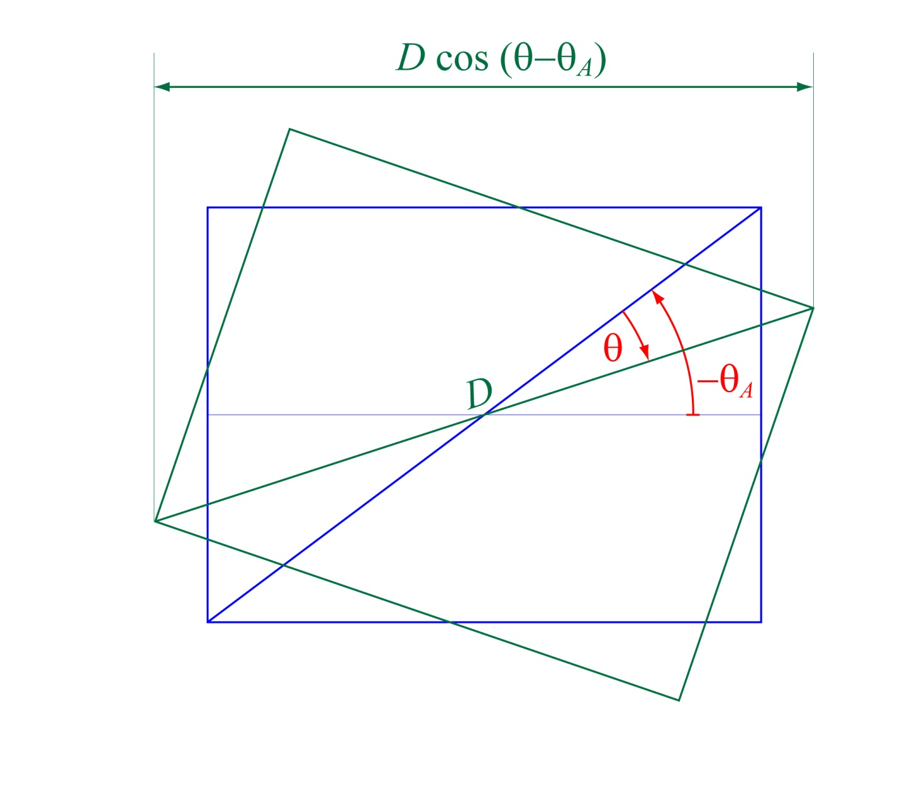
Image Rotation
Compute the dimensions of the output image: number of columns.
if 0° < θ ≤ 90°.

Slide 45
Image Rotation
The output dimension calculation depends on the value of θ as follows:
If 0° ≤ θ < 90°:
If 90° ≤ θ < 180°:
If – 90° ≤ θ < 0°:
If – 180° ≤ θ < – 90°:

Slide 46
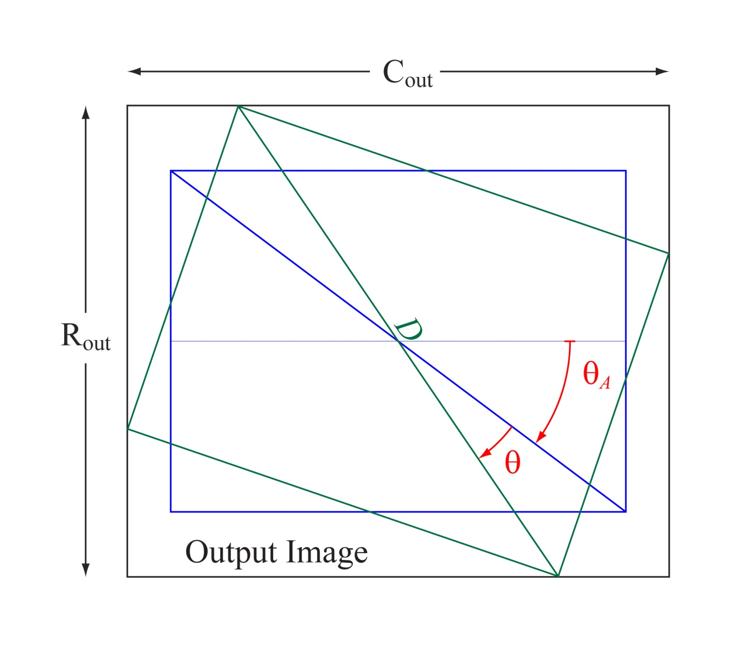
Image Rotation
Allocate an output image with dimensions (R_{out},C_{out}), where¹
and center point
¹R_{out} and C_{out} below are valid for 0° < θ ≤ 90°. Otherwise see slide 45.

Slide 47
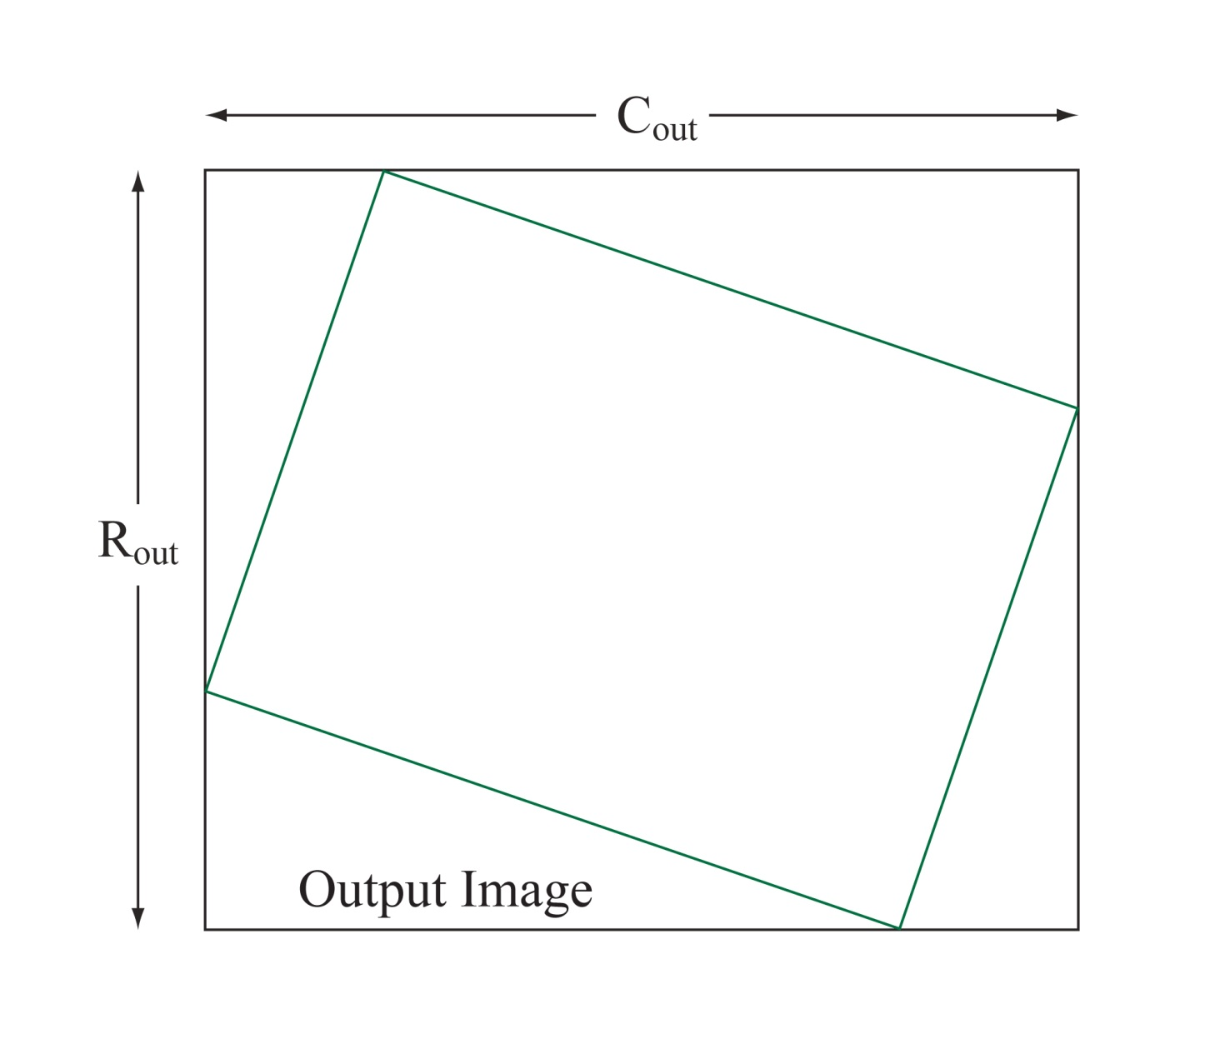
Image Rotation
Work backward. For every output loc. (r,c) select an input loc. (r_{f} ,c_{f}) by rotating (r,c) around the image center by -θ.

Slide 48
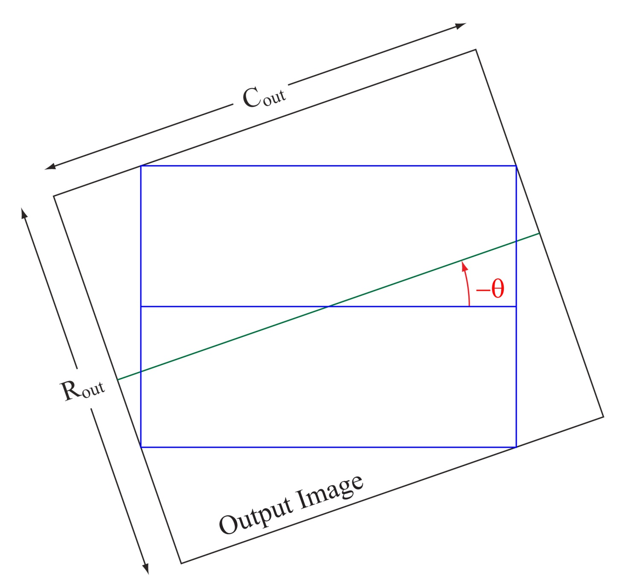
Image Rotation
Rotating the input image by θ is equivalent to rotating the ouput image by -θ.

Slide 49
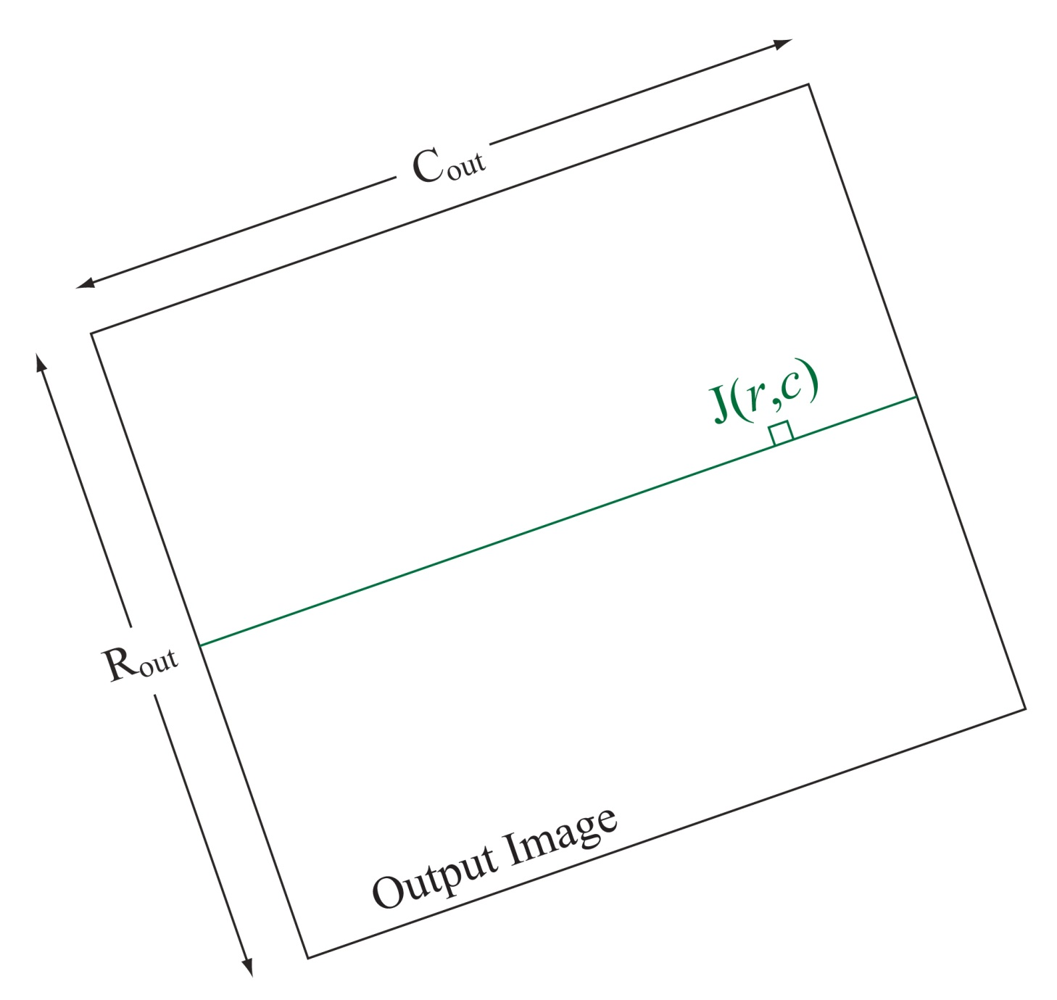
Image Rotation
After rotation by -θ, J(r,c) is in nearly the same position as I(r_{f},c_{f}).

Slide 50
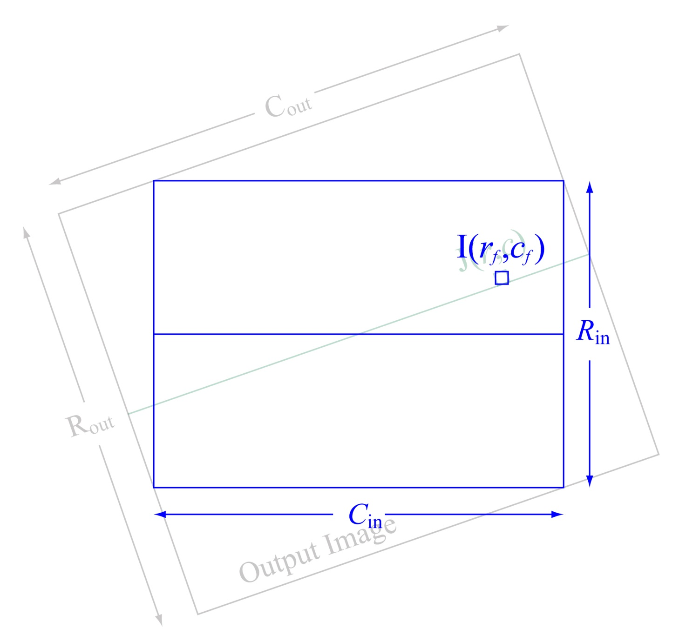
Image Rotation
After rotation by -θ, J(r,c) is in nearly the same position as I(r_{f},c_{f}).

Slide 51
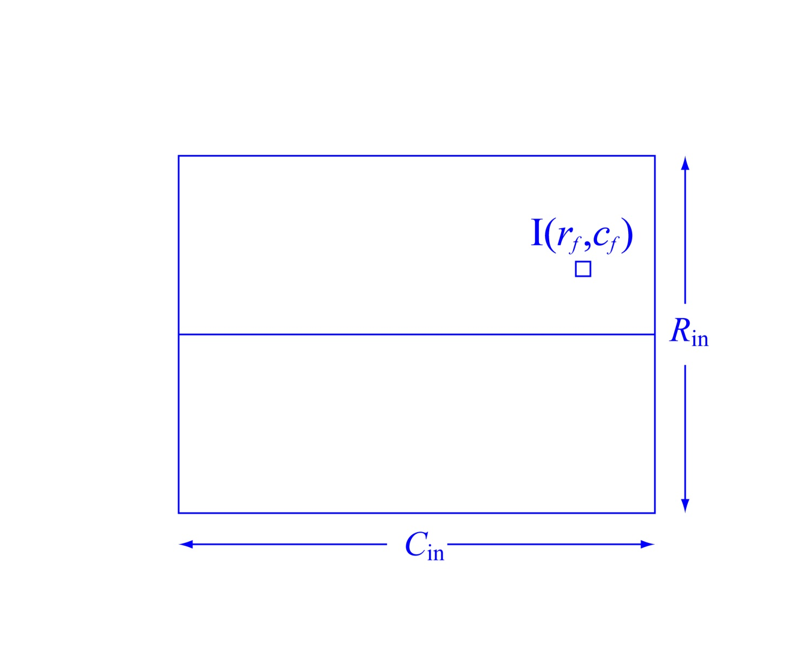
Image Rotation
After rotation by -θ, J(r,c) is in nearly the same position as I(r_{f},c_{f}).

Slide 52
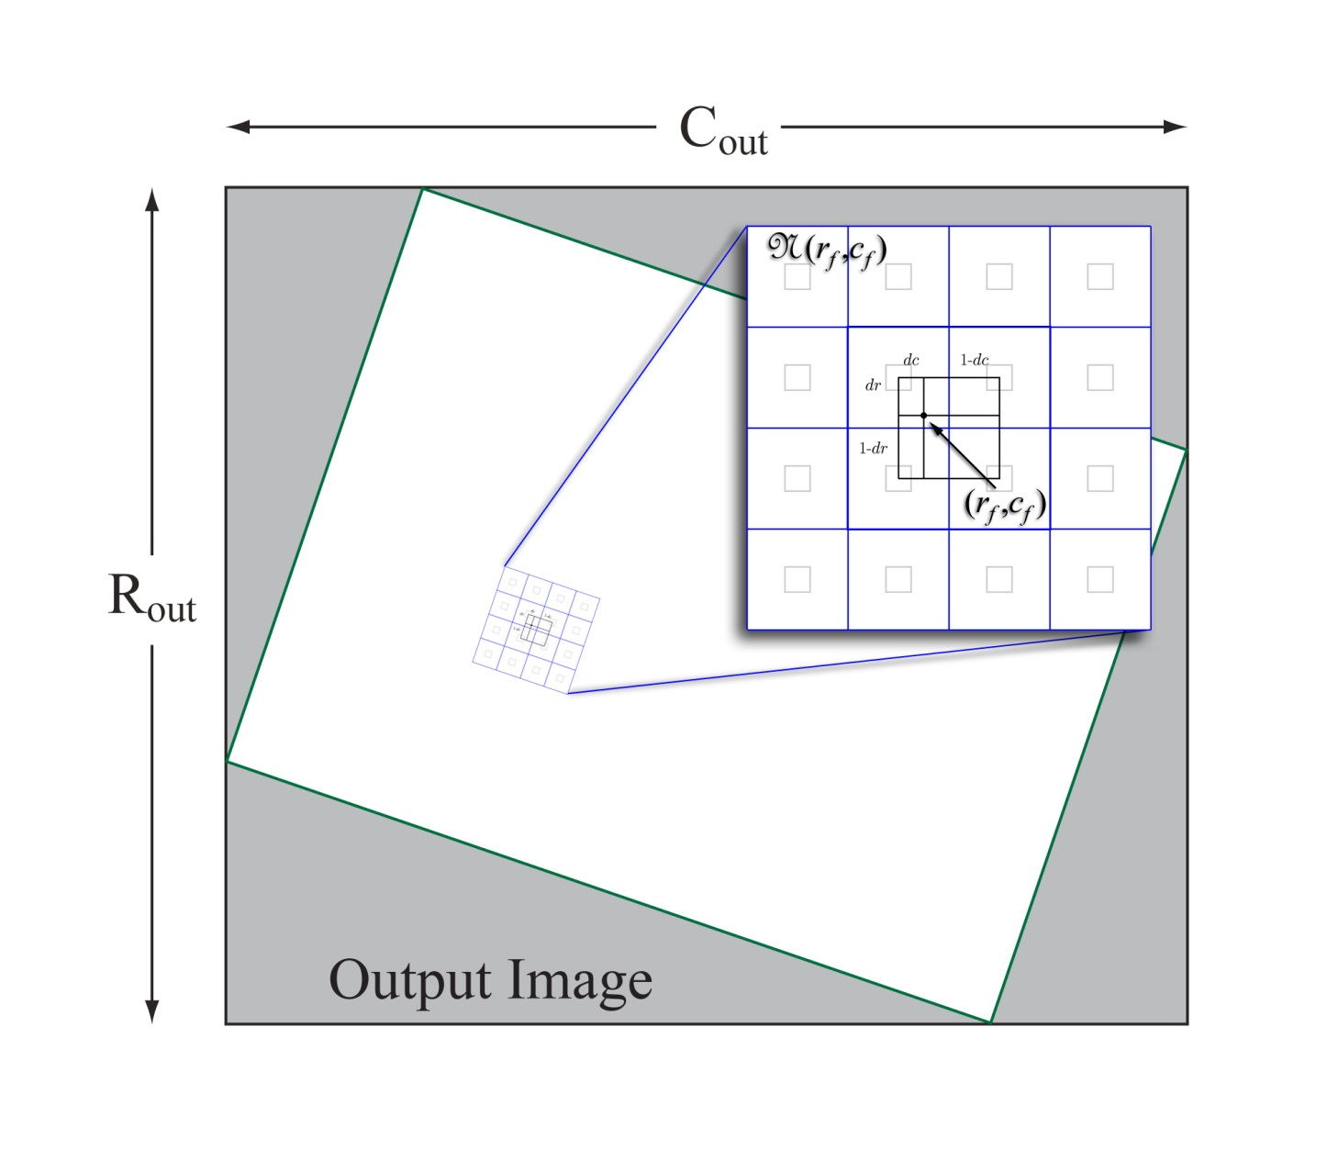
Image Rotation
Interpolation:
The output pixel value is (usually) a function of the values on a neighborhood – a set of pixels that surrounds – (r_{f} ,c_{f} ).
Bilinear Interp. uses a 2×2 neighborhood, bicubic uses a 4×4.
Nearest neighbor is simply,
J(r,c) = I(r_{i} ,c_{i} ) where (r_{i} ,c_{i} ) = round(r_{f} ,c_{f} ).

Slide 53
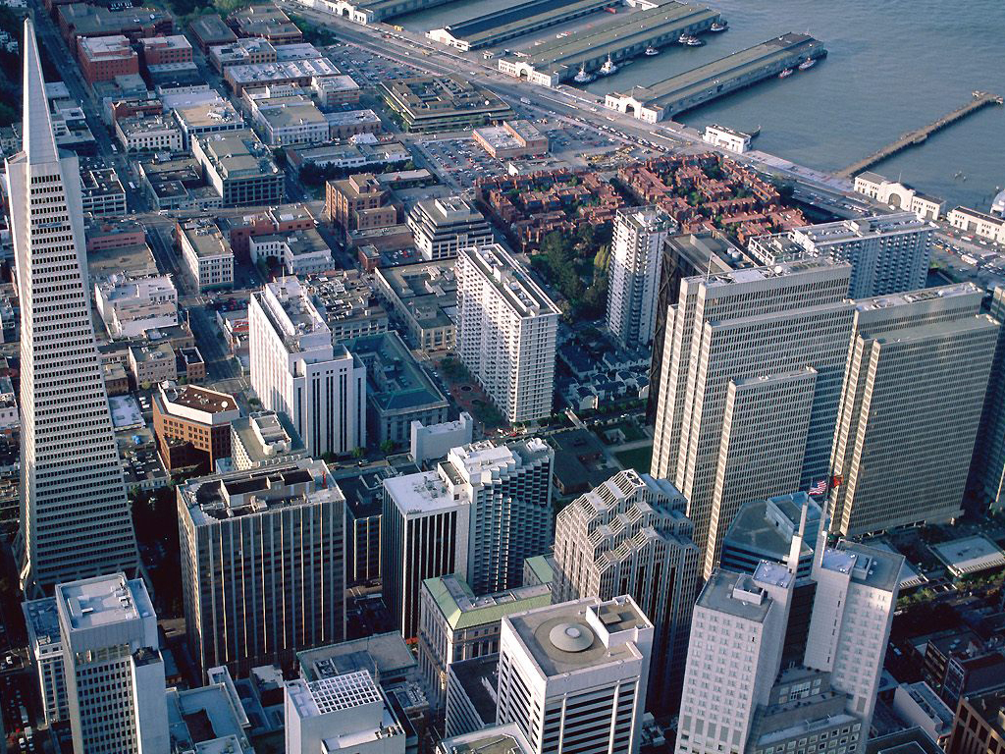
Image Rotation with Interpolation
Original image: San Francisco financial district

Slide 54
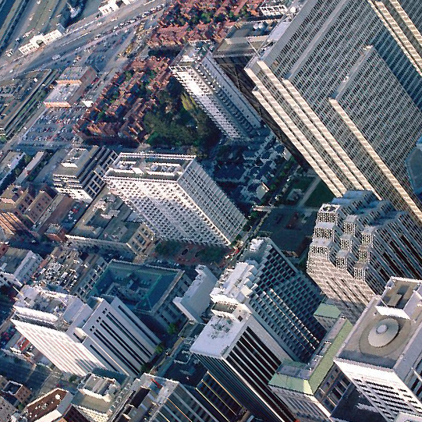
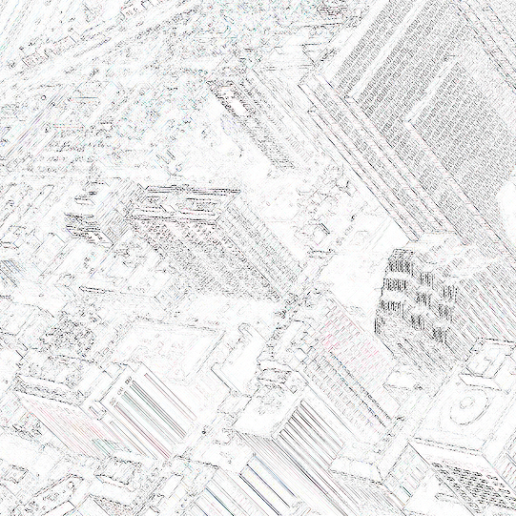
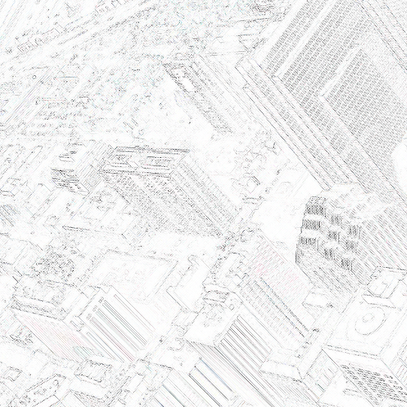
Image Rotation with Nearest Neighbor Interpolation
Bicubic – Nearest Neighbor
Nearest Neighbor – Bilinear

Slide 55

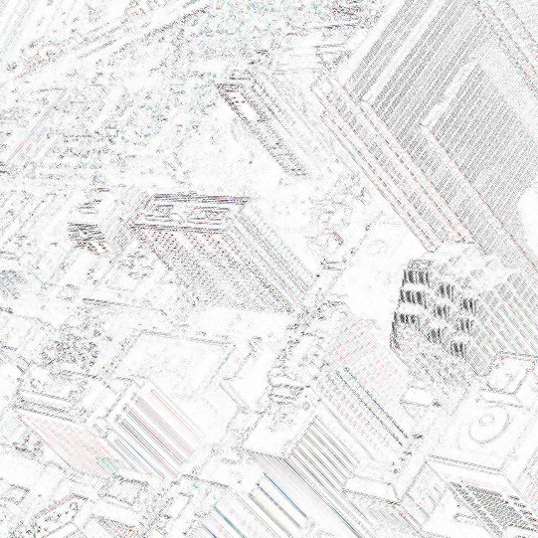
Image Rotation with Bilinear Interpolation
Nearest Neighbor – Bilinear
Bilinear – Bicubic

Slide 56
Image Rotation with Bicubic Interpolation
Bilinear – Bicubic
Bicubic – Nearest Neighbor

Slide 57

Example of Warping: Map Image to Sphere
For the output image,
For the input image,
For each output pixel,
For each output pixel, the input pixel loc is,

Slide 58
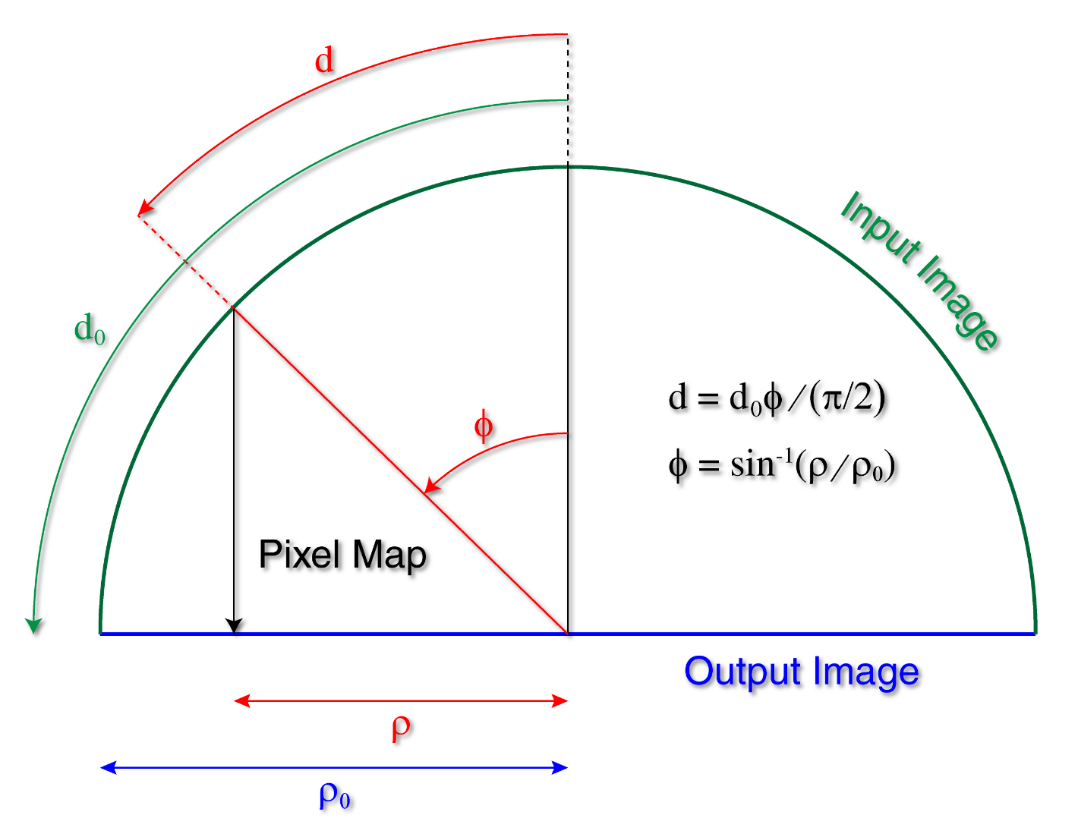
Example of Warping: Map Image to Sphere
d₀: ½ full dimension of input image.
ρ₀: same for output image.
d: radial distance from center of input image to pixel location.
ρ: same for output image.

Slide 59
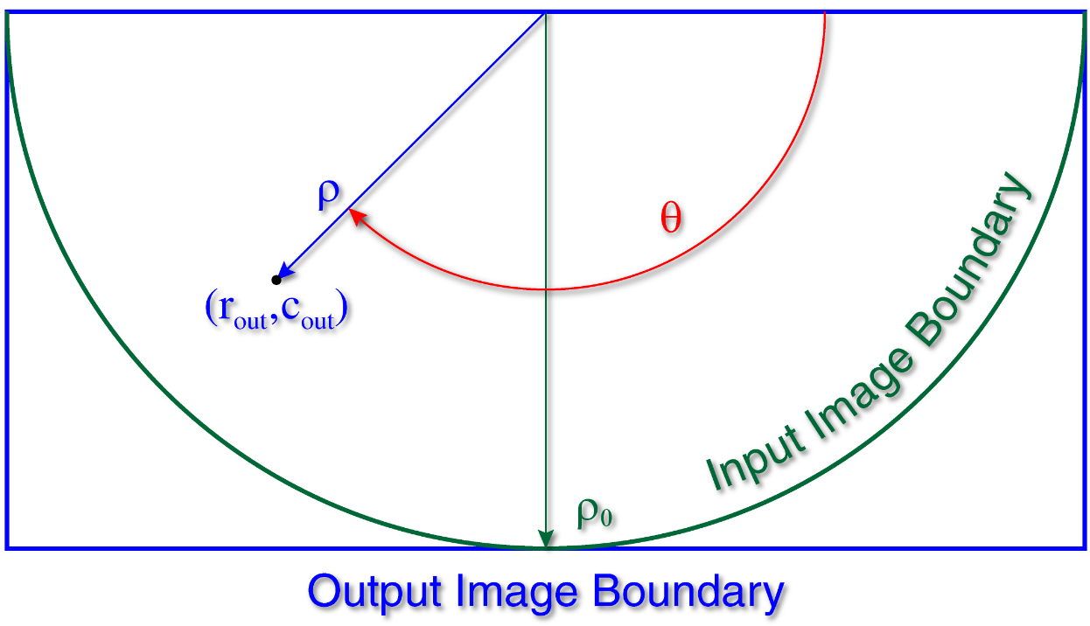
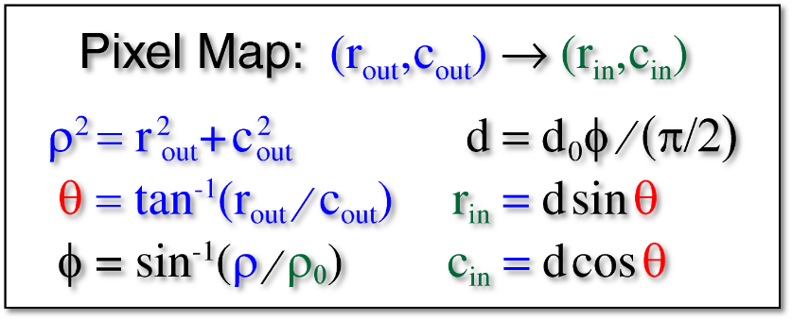
Example of Warping: Map Image to Sphere

